Slide 1


Attendance Marking through Face recognition
AI-FEST
Project Evaluation
Riza zulfiqar
Aleena ali
Fareesa siddiqui
Instructor: name here
Industry Partner: name (if any)
Department of Computer Science - DHA Suffa University

Slide 2


Summary
Project Brief Introduction
Problem Statement
Dataset Description
Project Scope
ML/DL/NLP Model Details
Results and Discussions
Tools and Technologies Learnt During the Project Implementation (Individual Skills Set)
Project Demo
References (last accessed)

Slide 3
Project Brief Introduction
The system takes 20 photos of a person's face via a camera and saves them in this directory. In the recognition section, new libraries for facial recognition and text-to-speech are imported, and global variables are set. Functions are supplied for loading known face encodings and names from saved photos, recording attendance by appending details to a CSV file, loading the YOLO model, and recognizing faces in a video frame, drawing bounding boxes and marking attendance for identified faces.The main function prompts the user to enter their ID and starts the face recognition process by capturing video from the webcam and processing it in real-time. This setup facilitates capturing images for new faces, storing them, and recognizing faces from a live video feed to mark attendance.

Slide 4
Problem Statement
Taking and recording attendance is a necessary but frequently tedious task in many schools, colleges, organizations, and businesses. There are various drawbacks to using traditional techniques like fingerprint scanners, RFID cards, and manual roll calls.
Time-Dependent Procedures: It takes time to manually call roll or scan each ID, which cuts into the amount of time allotted for meetings or instruction.
Human error: Inaccurate or missing attendance records can result from manually maintaining attendance registers.
Fraudulent Practices: These conventional techniques are vulnerable to proxy attendance, in which one person logs in as someone else.

Slide 5
Problem Statement
A face recognition system, on the other hand, has the following benefits:
Efficiency: Automated face recognition systems save a great deal of time and allow employees to concentrate more on productive tasks by efficiently and accurately recording attendance.
Accuracy: Face recognition systems reduce the possibility of human error by utilizing sophisticated algorithms, guaranteeing accurate and dependable attendance records
Security: Since face recognition is hard to spoof or get around, it offers a high level of security. By ensuring that only authorized individuals are listed as present, this lowers the possibility of dishonest behaviors like proxy attendance.
Convenience: Face recognition technology, non-intrusive design makes it easy to incorporate into daily activities without requiring face-to-face interaction or the use of extra equipment like cards or scanners.
Scalability: Face recognition systems are perfect for any size institution or organization because they can readily grow to accommodate large numbers of people.
Data analytics: These systems can offer insightful data, including attendance patterns and trends, which can aid in decision-making and boost productivity all around.

Slide 6
Dataset Description
The YOLOv8-n model is typically trained on the COCO (Common Objects in Context) dataset. Here's a detailed breakdown of the COCO dataset from basics to advanced aspects:
COCO: The Common Objects in Context (COCO) dataset is a large-scale object detection, segmentation, and captioning dataset designed to advance the state of the art in computer vision tasks.
Dataset Size:
Images: Contains over 200,000 labeled images.
Annotations: Provides over 1.5 million object instances annotated.
Categories:
Number of Categories: Includes 80 object categories.
Examples: People, animals (dog, cat, bird), vehicles (car, bus, bike), household objects (bottle, chair, sofa), and more.

Slide 7
Dataset Description
The dataset includes a collection of images where faces are prominently visible. These images come from web camera.Images are stored in JPEG format.
Labels: Each bounding box is associated with a label that identifies the person in the bounding box. This label is used for the face recognition task.
File Structure:The dataset is organized into directories, each directory corresponds to a different person.

Slide 8
Project Scope
Project Objectives:
The main purpose of the project is to recognize person through faces and mark their attendance in a csv file.The system compares the features of persons to recognize the person and show their roll no as label at the top of the frame in a web cam.
In-Scope Items:
Specify the features and functionalities that will be included in the project. For instance:
Face detection using the YOLO model.
Face recognition using the face_recognition library.
Attendance marking and logging.
Text-to-speech notifications.
User interface for capturing and recognizing faces.

Slide 9
ML/DL/NLP Model Details
YOLO Family: YOLO models are designed for real-time object detection. They divide the image into a grid and predict bounding boxes and class probabilities for each grid cell.
YOLOv8: The eighth iteration of the YOLO series, it builds upon the advancements of its predecessors, improving both speed and accuracy.
YOLOv8-n Characteristics:
Lightweight: YOLOv8-n is optimized for speed and efficiency, making it suitable for edge devices and real-time applications.
Architecture: It has a smaller architecture compared to larger YOLOv8 variants, reducing computational requirements.
Feature Extraction: The backbone is responsible for extracting features from the input image. YOLOv8-n uses a lightweight convolutional neural network (CNN) architecture for this purpose.
Efficiency: It may use techniques like depth wise separable convolutions to reduce the number of parameters and computational load.

Slide 10
ML/DL/NLP Model Details
Input Layer:
Image Input: YOLOv8n takes an image as input. The size of the input image can vary, but it is typically resized to a standard size like 640x640 pixels for consistent processing.
Backbone:
Feature Extraction: The backbone is a Convolutional Neural Network (CNN) that extracts features from the input image. Common backbones include models like CSPDarknet or MobileNet, which are designed to capture important features at various levels of abstraction.
Neck:
Feature Pyramid Network (FPN): The neck is responsible for aggregating features from different layers of the backbone. This allows the model to make predictions at multiple scales, which is crucial for detecting objects of varying sizes.

Slide 11
ML/DL/NLP Model Details
Output:
Bounding Boxes, Class Scores, and Confidence Scores: The final output consists of bounding boxes that indicate the location of detected objects, class scores that indicate what type of object has been detected, and confidence scores that measure the certainty of each detection.
Head:
Detection Layers: The head of the model generates the final output predictions. It consists of several convolutional layers that predict the bounding boxes, object classes, and confidence scores. YOLOv8n typically has three detection layers, each responsible for detecting objects at a different scale.

Slide 12
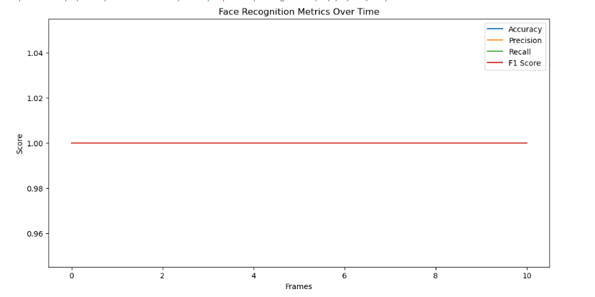
Results and Discussions
From the graph, it appears that:
The F1 Score is consistently plotted at around 1.00 over the frames, indicating high consistency in this metric.
Other metrics (Accuracy, Precision, Recall) are not visible in the graph, suggesting that their values might not have changed or they might be constant, similar to the F1 Score.
The console logs above the graph provide additional context about the face detection process, showing the time taken for preprocessing, inference, and postprocessing per image. The output suggests that:
The detection process identifies faces and processes images in various resolutions (e.g., 480x640).
The inference times are also provided, indicating how long the model takes to make predictions.
In summary, the graph demonstrates the stability of the F1 Score metric over time during face recognition, with no significant fluctuations observed.

Slide 13
Project Demo
The system firstly takes the roll no of person entered in the system and opens webcam of the laptop.When the camera is opened the system recognize person unknown if the person is new to the system and shows roll no of the person for known persons.These labels are shown at the top of the frame.After which the attendance is marked if the person is known to the system.To detect new persons, 20 pictures will be taken and stored in the directory of known persons.Each person will have their own directory in known_faces directory with their respective roll no.The system mark attendance of the person in a csv file with time date and their roll no.

Slide 14
Tools and Technologies Learnt During the Project Implementation
Jupyter Notebook:Jupyter Notebook is an interactive development environment used for data analysis, visualization, and collaboration.
GitHub: GitHub was used to host the project repository.
VSCode (Visual Studio Code):It was used for writing, debugging, and organizing code in Python.
Anaconda: It simplified package management and environment setup, making it easier to work with libraries like OpenCV, NumPy, and pandas.
OpenCV (Open Source Computer Vision Library): OpenCV is a library of programming functions mainly aimed at real-time computer vision. In a face recognition system, OpenCV provides tools and algorithms for tasks such as face detection, face tracking, image processing, and video analysis.
yolov8n-face.pt (YOLOv8n face detection model):YOLO (You Only Look Once) is a family of real-time object detection models, and YOLOv8n refers to a specific version optimized for face detection. The .pt file likely contains the pre-trained weights of the YOLOv8n model, which can be used to detect faces in images or video streams.
NumPy. NumPy is essential for efficient data manipulation and processing in face recognition systems.
pandas:It offers data structures like DataFrames that are particularly useful for handling structured data (like datasets of face images or information about detected faces).
pyttsx3:pyttsx3 is a text-to-speech conversion library in Python.

Slide 15
8- Reference
Examples
Website reference
https://docs.ultralytics.com/tasks/detect/#predict
https://encord.com/blog/yolo-object-detection-guide/

